Slide 1
Duval County Public Schools
Joint Meeting with the City Council
September 21, 2016

Slide 2
Homeless Education

Slide 3
Definition of Homeless
As defined by the McKinney Vento Homeless Assistance Act:
Children or youth who lack a fixed, regular, and adequate nighttime residence including:
Sharing the housing of other persons due to loss of housing, economic hardship, or a similar reason
Living in motels, hotels, trailer parks or camping grounds due to the lack of alternative adequate accommodations
Living in emergency or transitional shelters

Slide 4
District Enrollment Data
82% of students identified as homeless fit the identification due to living in shared housing.

Slide 5
State Reporting Categories for Homeless
District Number | District Name | Homeless Students (Survey 5)
 |  | Emergency Shelter | Shared Housing | Cars, Parks, Temporary Trailers | Hotel/ Motel | Awaiting Foster Care | Homeless Total | Not Defined as Homeless
16 | DUVAL | 193 | 1,845 | 17 | 161 | 41 | 2,257 | 141,373
2,257 students were identified as homeless last school year.

Slide 6
State Reporting Categories for Homeless
District Number | District Name | Unaccompanied Youth
 |  | Homeless, NOT Unaccompanied | Homeless, Unaccompanied | Not Homeless
16 | DUVAL | 1,941 | 316 | 141,373
14% of students experiencing homelessness are not accompanied by an adult.

Slide 7
Response to the Data
Shelters are not always a readily available option for a variety of reasons:
Many shelters are at capacity
Inadequate room for the entire family
Families unwilling to be separated; adolescent male may be required to go to the male quarters of the shelter
Safety concerns (risk of theft or lack of privacy)
As a result, a significant number of families must share housing or “double up” with a family member or friend.

Slide 8
Promotion and Graduation Data Homeless Students 2015-2016
Indicator | Number of Students | Percent of Students
Promotion K-12 | 2005 out of 2257 | 88%
Graduation (seniors only) | 72 out of 108 | 67%
Promotion rates are up 6% and the Graduation Rate is up 3.5% from the
2014-2015 school year.

Slide 9
Supporting Homeless Students
Assisting with paperwork
Helping with school enrollment
Arranging transportation from new living arrangement
Providing school supplies
Purchasing school uniforms
Waiving school fees
Staffing clothes closet through DignityUWear
Providing athletic fees
Providing tutoring assistance
Arranging ACT/SAT test prep and registration waivers
Connecting to outside agencies for assistance

Slide 10
ADDITIONAL Funding
$108,000 - Title X Part C Homeless Education Program
$180,000 - Title I Part A Homeless Set-Aside
$128 in federal funding per homeless student
Notes:
$288,000 does not cover the full cost of the program: biggest expenses are:
the four social workers that do everything from assisting in getting birth certificates and duplicate social security cards to meeting with school counselors for enrollment purposes.
Transportation
Tutoring

Slide 11
Homeless Office Contact Information
Duval County Public Schools Dropout Prevention Office
904.390.2347
http://dcps.duvalschools.org/Domain/8617
Executive Director – Dr. Pamela Davis | davisp3@duvalschools.org
Supervisor – Mr. Jamie Griffin | griffinj1@duvalschools.org
Lead Social Worker – Ms. Tricia Pough | pought@duvalschools.org

Slide 12
Capital and New Construction

Slide 13
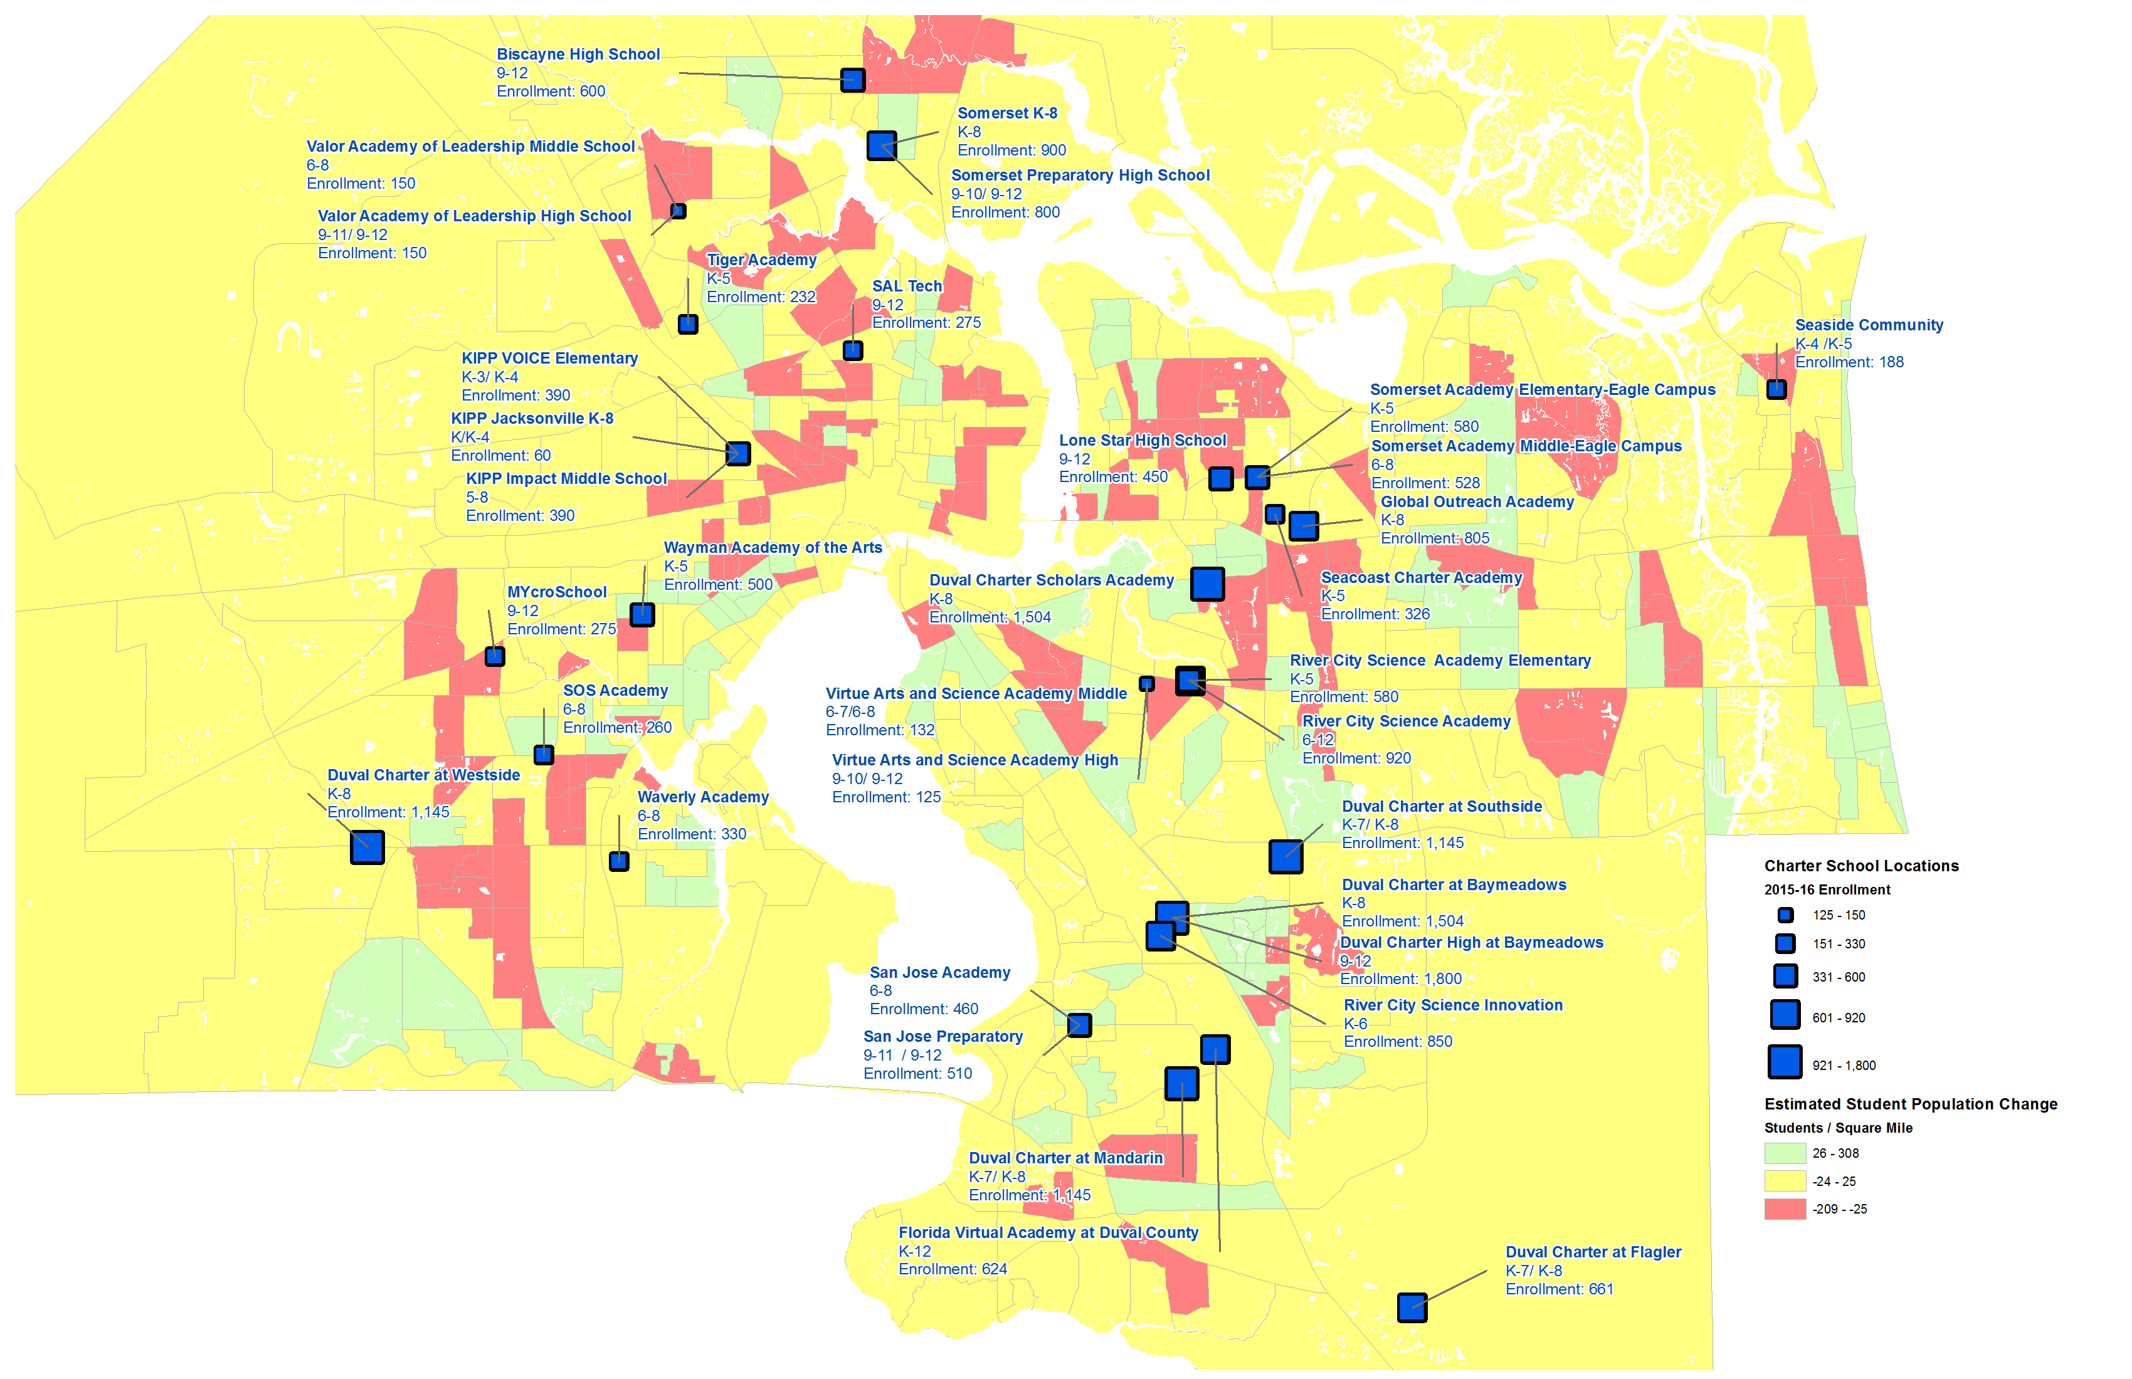

Slide 14
History of Capital funding Challenges
Lack of suitable funding to address the evolution of technology with increased demand for blended learning and online testing
Continuing aging of buildings and the need to renovate, repair, replace with a lack of funding
Competitive ability to construct new buildings or use wings to address high growth residential areas.
State decreased millage by .25 in 2009 and then again in 2010. This led to less revenue for capital:
In 2008, the district received $117 million from millage
In 2009, the district received $108 million from millage
In 2010, the district received $89 million from millage
In 2015, the district received $83.1 million from millage

Slide 15
CURRENT MAJOR/MINOR MAINTENANCE SHORTFALL
Year | MM Funding Level | Identified MM Backlog | Growth Per Year | Average Growth
2016-17 | $12.9M | $103M
2017-18 | TBA | $108.2M | $5.1M | $5.7M
2018-19 | TBA | $113.6M | $5.4M | $5.7M
2019-20 | TBA | $119.3M | $5.7M | $5.7M
2020-21 | TBA | $125.3M | $6.0 M | $5.7M
2021-20 | TBA | $131.6M | $6.3M | $5.7M

Slide 16
Enrollment
Year | Enrollment | Capacity | Utilization Rate
2015-2016 | 112,425 | 138,947 | 81%
2016-2017 | 113,896 | 137,907 | 82%

Slide 17
Construction project schedule
Four Phases to the Process:
Long Range Planning
Funding
Design
Construction

Slide 18
Long-range Planning phase
Analysis of excess capacity in the district vs. need in a particular area of the city
Analysis of future need, based on city planning data
Show good faith effort toward using or removing excess seats
Moving usable portables to areas where needed
Demolishing unusable/worn portables
Selling unused or leased buildings
Changing boundaries, as needed
Engage constituents in the district AICE process
School Board Plant Survey Approval
FDOE Plant Survey Approval

Slide 19
Master Planning Factors
Facility Needs Assessment and Capacity Analysis
Current facility conditions – Maintenance Requirements
Current school capacities
Continued reduction of portable classrooms
Demographic Analysis/Enrollment Projections
COJ Planning and Development Information
US Census Report
Academic and Diversity Program Development Needs
Boundary Analysis
Shifts in population growth and diversity
Overall impact on communities
School consolidation and boundary changes

Slide 20
Funding phase
1. APPROVE FUNDING:
School Board approval of Five-Year Capital Plan
Board Approval – COPS Bond Reimbursement
Board Approval – COPS Bond Resolution
2. ISSUE BONDS:
Issue COPS
COPS Bond Debt Service Payback begins in the Construction Phase

Slide 21
Design phase
Begin Design
Select Architect/Engineering Firm
Board Approval of Architect/Engineering Firm
Select Construction Manager
Board Approval of Construction Manager Selection
Board Approval of Construction Manager Contract
Complete Design
Board Approval of Design Contract

Slide 22
construction phase
Required Inspections during Construction Phase:
Sitework
Building
Plumbing
Mechanical
Gas
Fire Suppression Systems
Electrical
Groundbreaking
Construction
COJ Fire Marshal Inspection
Certificate of Completion
Certificate of Occupancy

Slide 23
NEW construction TIMELINE
Approve Funding & Issue Bonds
4 Months
Select Architect/ Engineering Firm
5 Months
Select Construction Manager
5 Months
Complete Design
6 Months
Complete Construction
14 Months
Total K-8 Construction Duration from Funds Approval – 30 months

